Slide 1


CENTRAL-ZOO
ADSE – Batch 161 – eProject Semester 1
Tutor: Mr. Nguyen Van Trong

Slide 2
Team
Le Dinh Tuan
Hoang Trong Son
Nguyen Thanh Hoai Chau

Slide 3
REQUIREMENTS
Logo
User friendly
Uniformity color
Contacts Us
About Us
GeoLocation API
Animal’s information
Gallery
Timings of the zoo
Navigation is made smooth
Events organized
Feedback Query

Slide 4
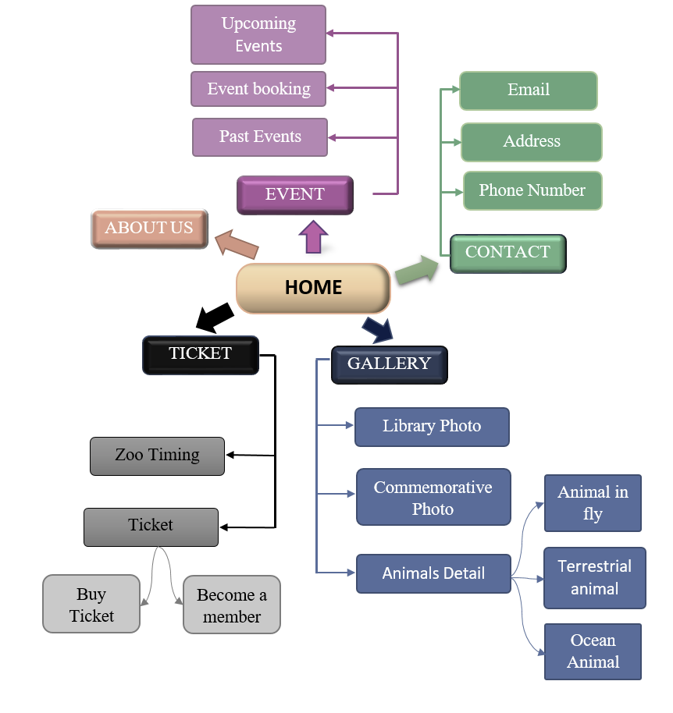
SITE MAP

Slide 5
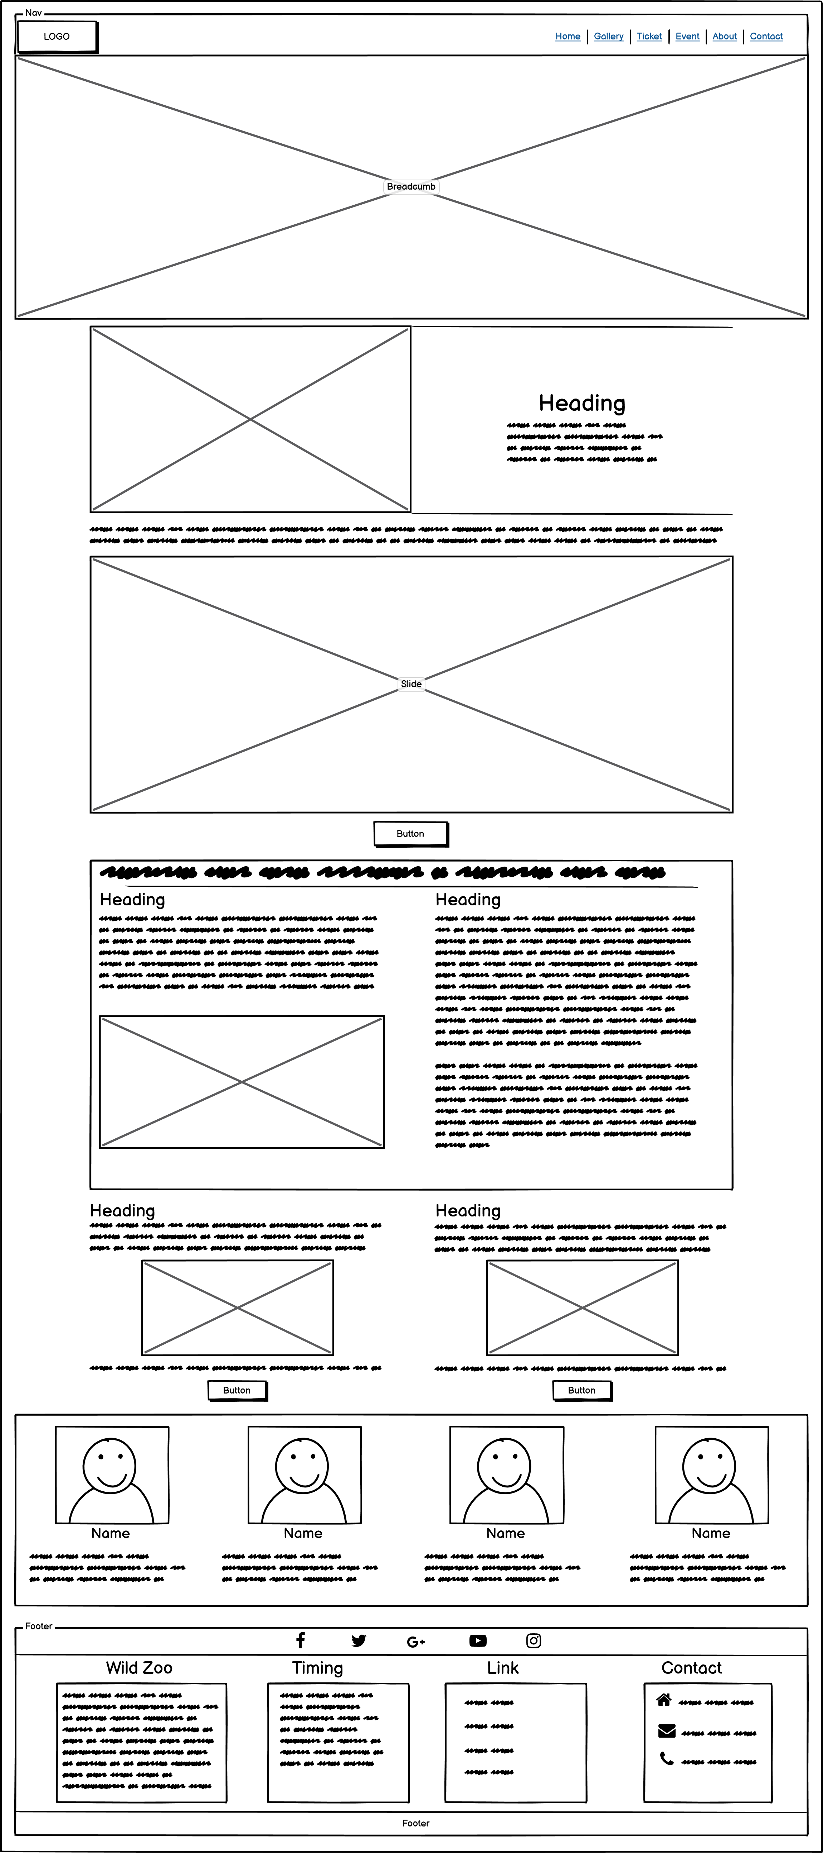
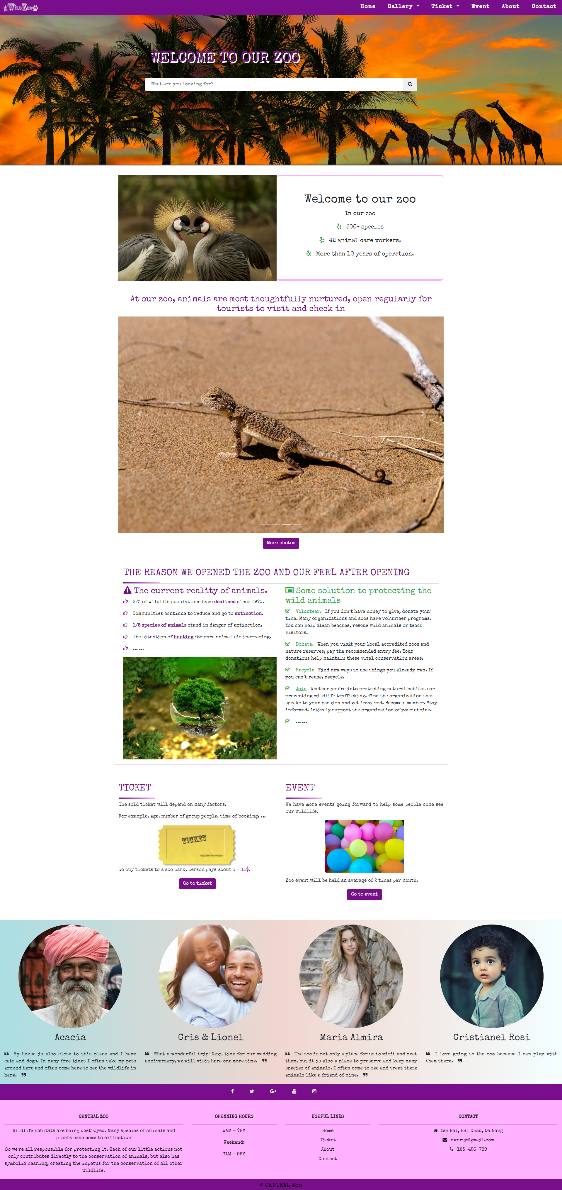
Home

Slide 6
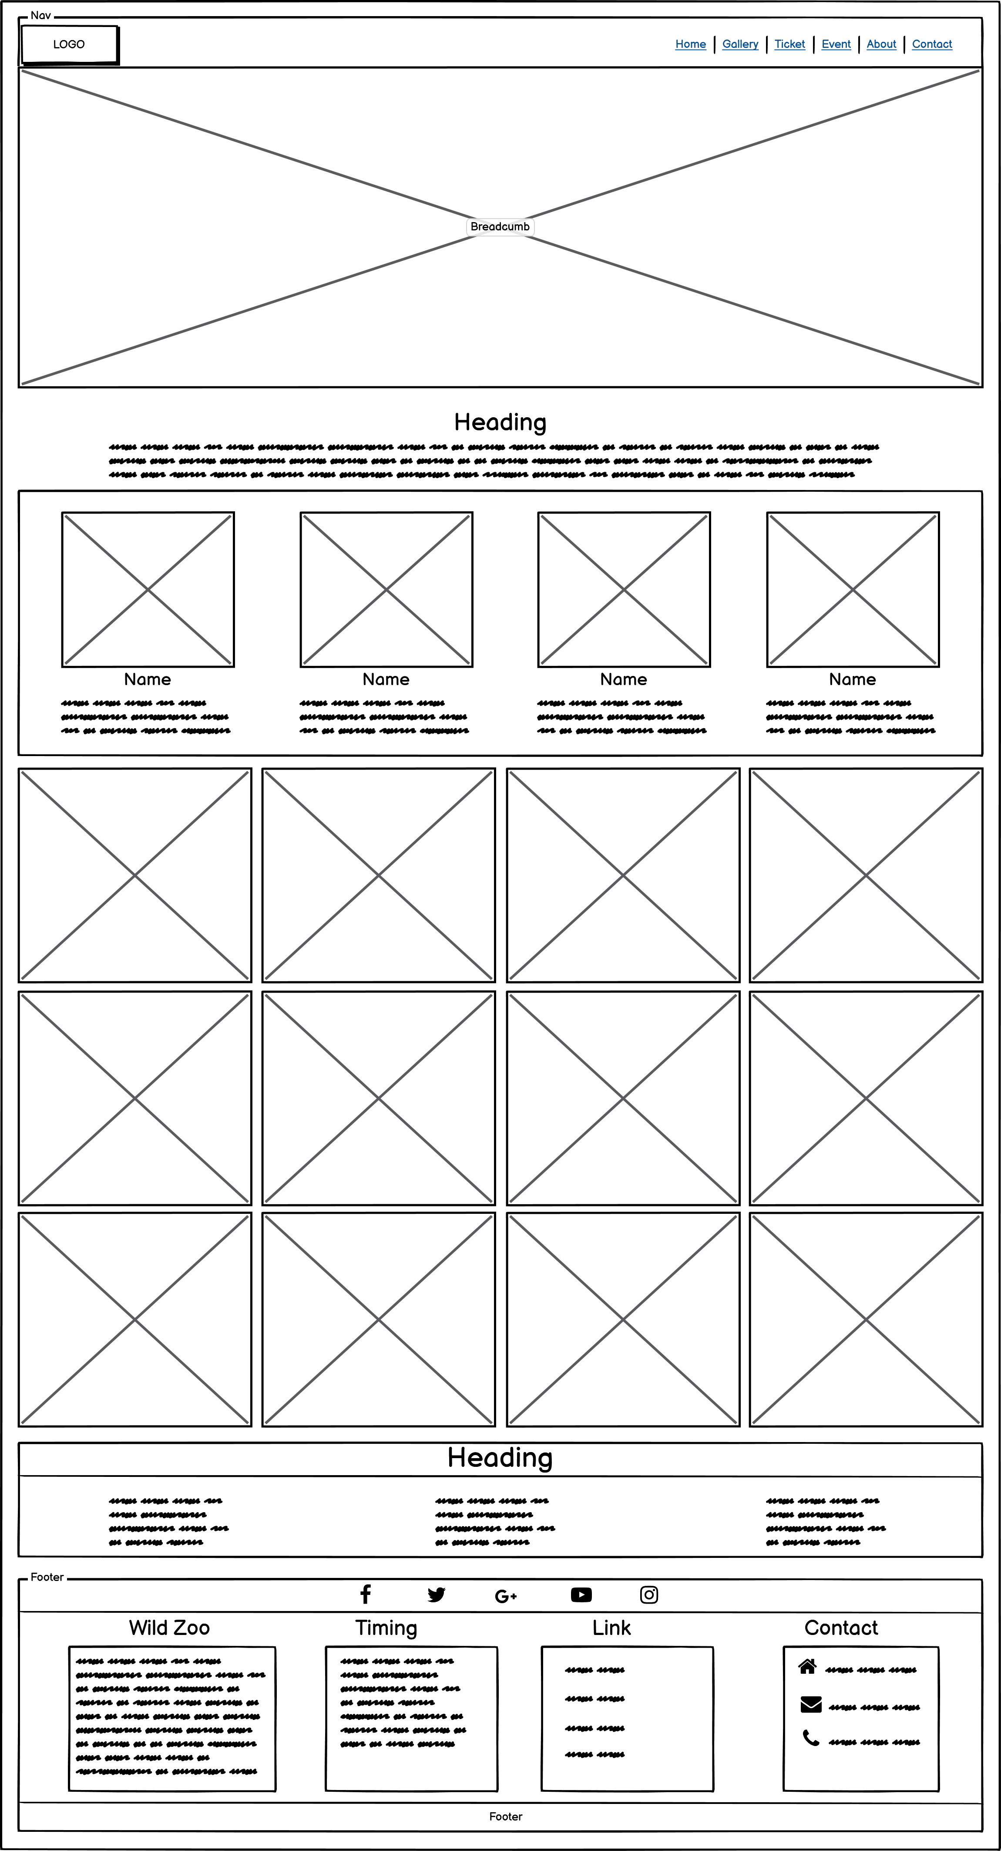
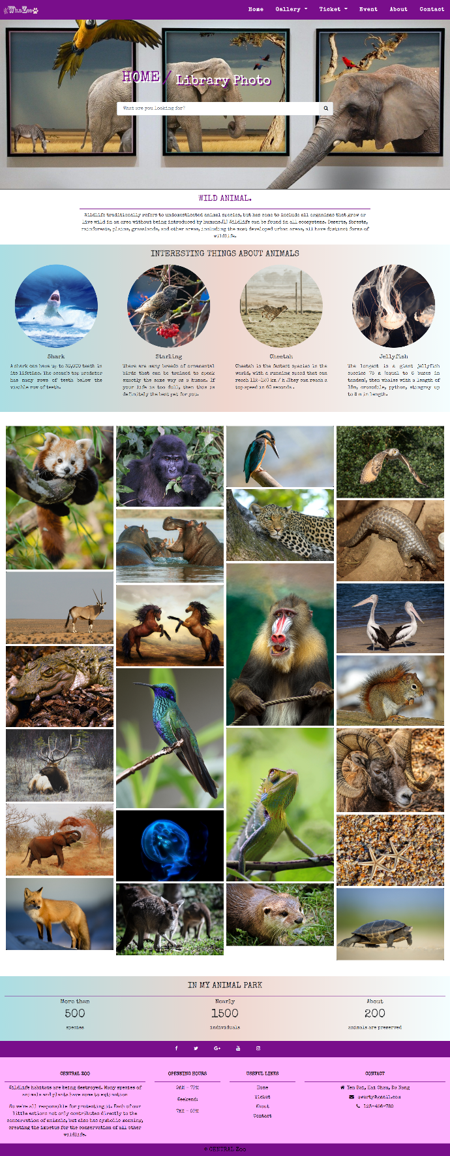
Library Photo

Slide 7
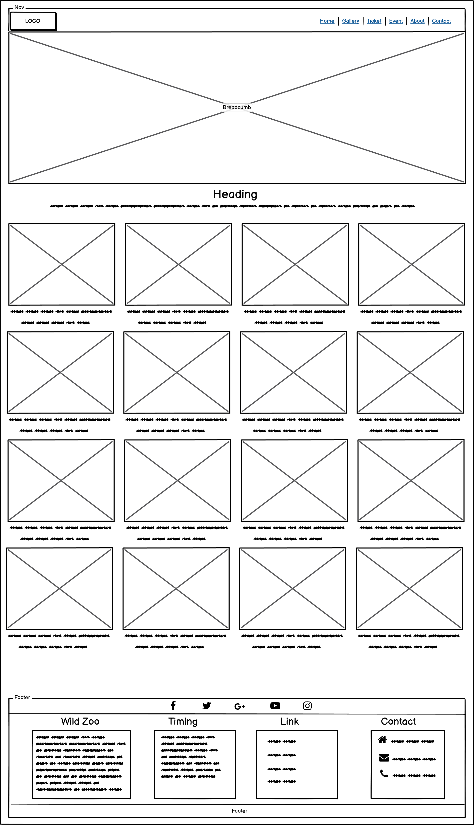
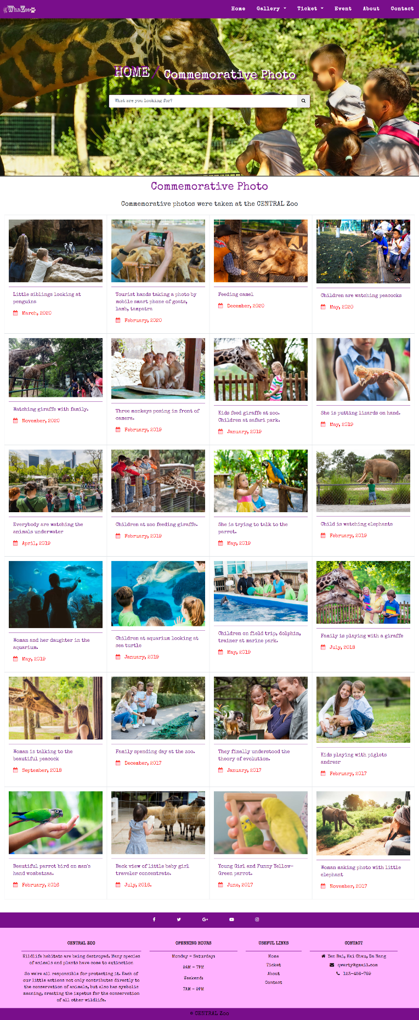
Comemorative Photo

Slide 8
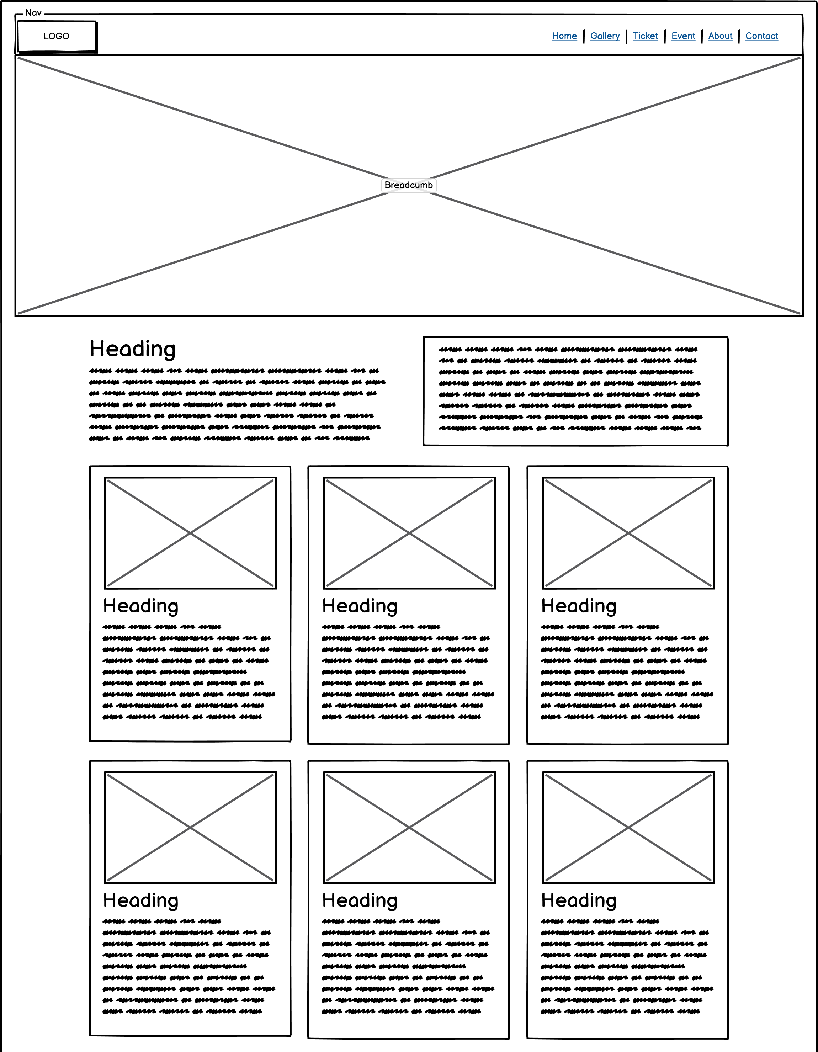
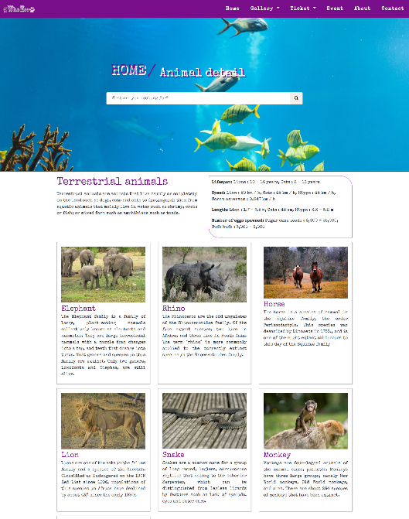
Animal Detail

Slide 9
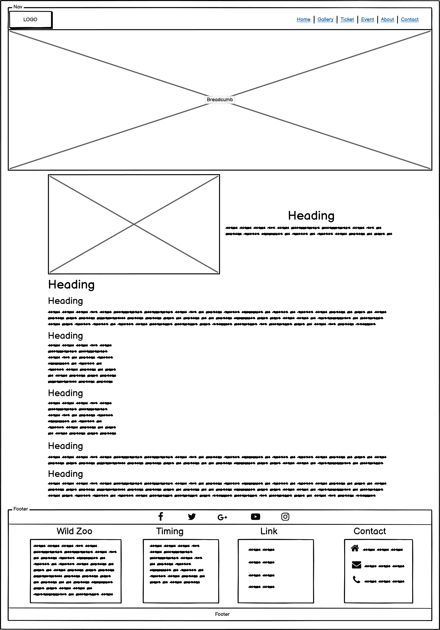
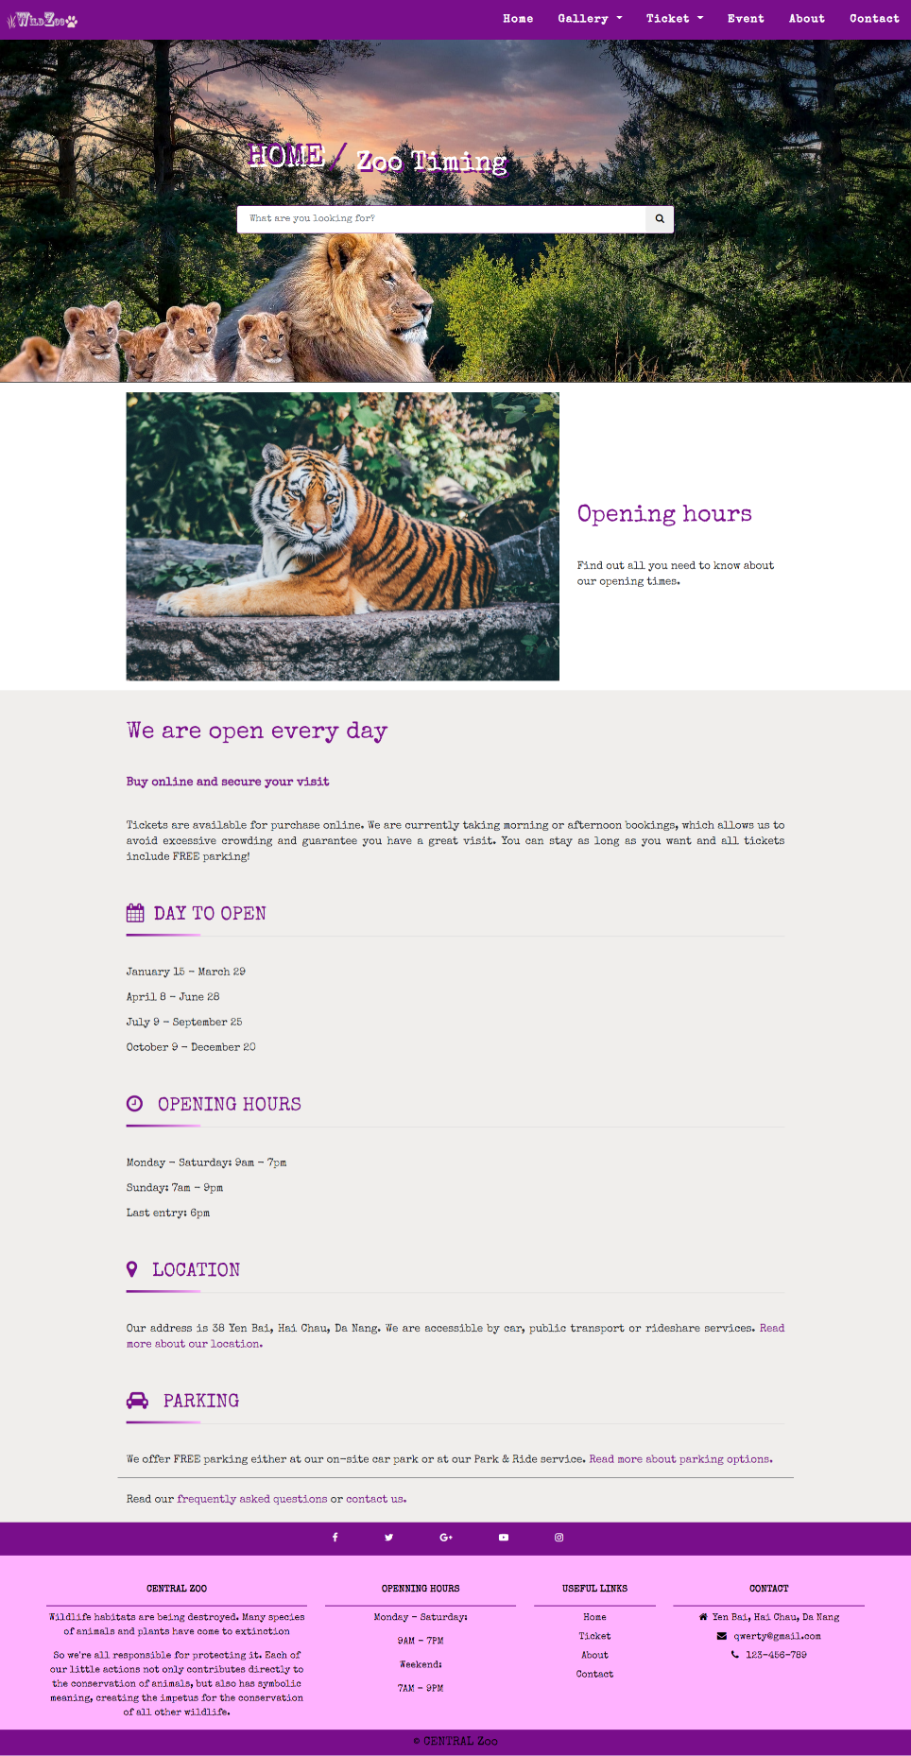
Zoo Timing

Slide 10
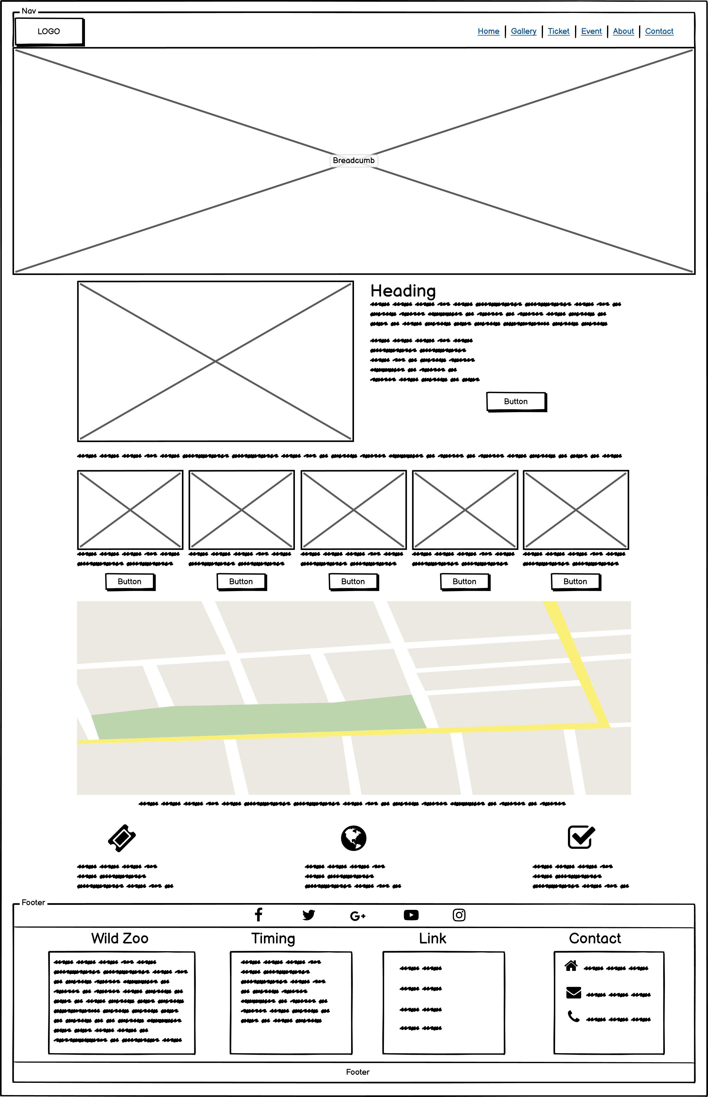
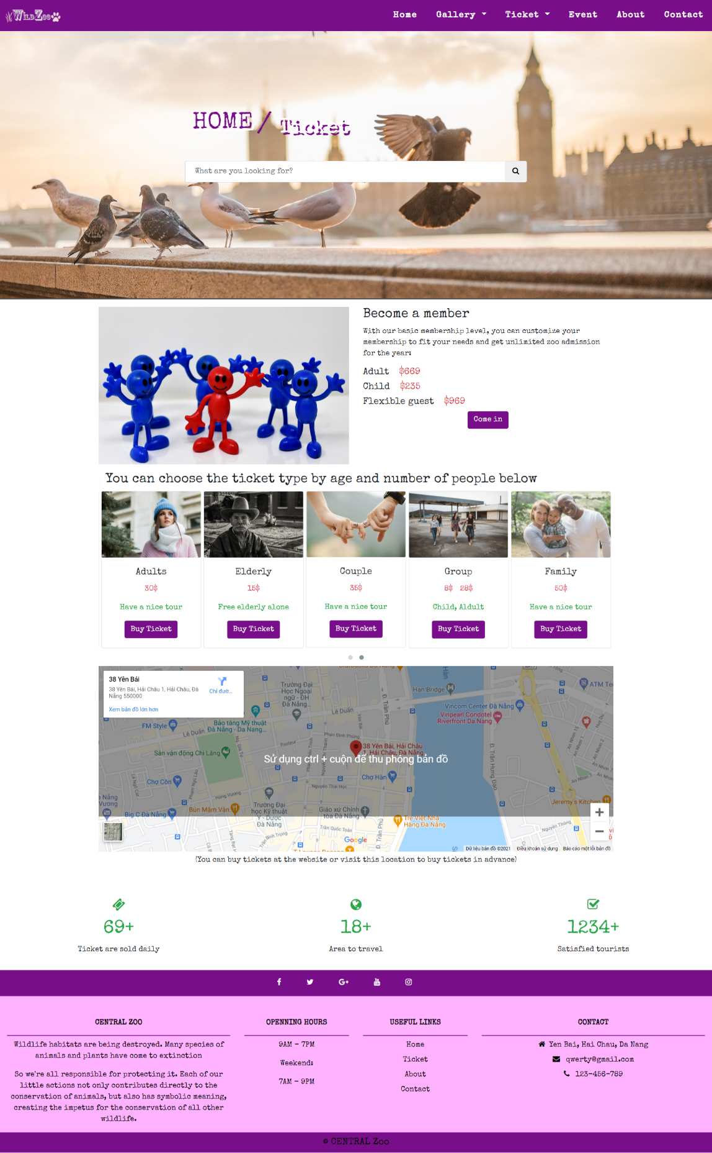
Ticket

Slide 11
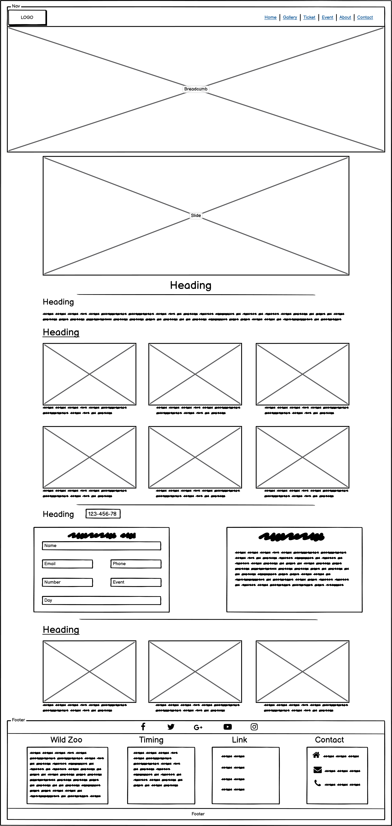
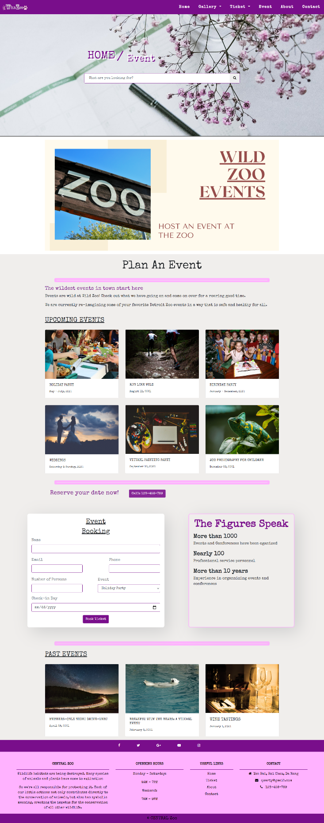
Event

Slide 12
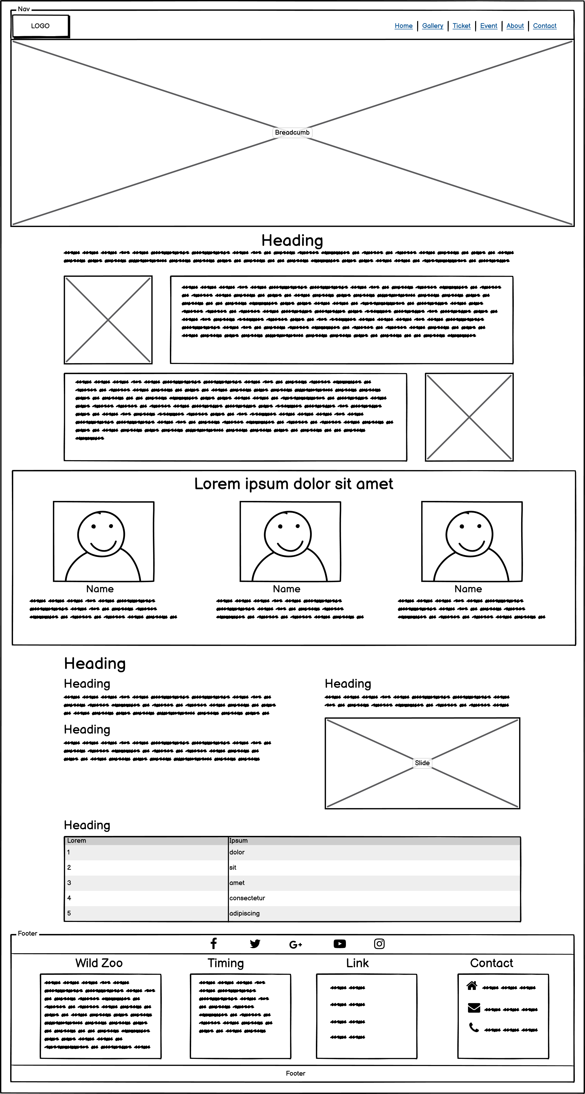
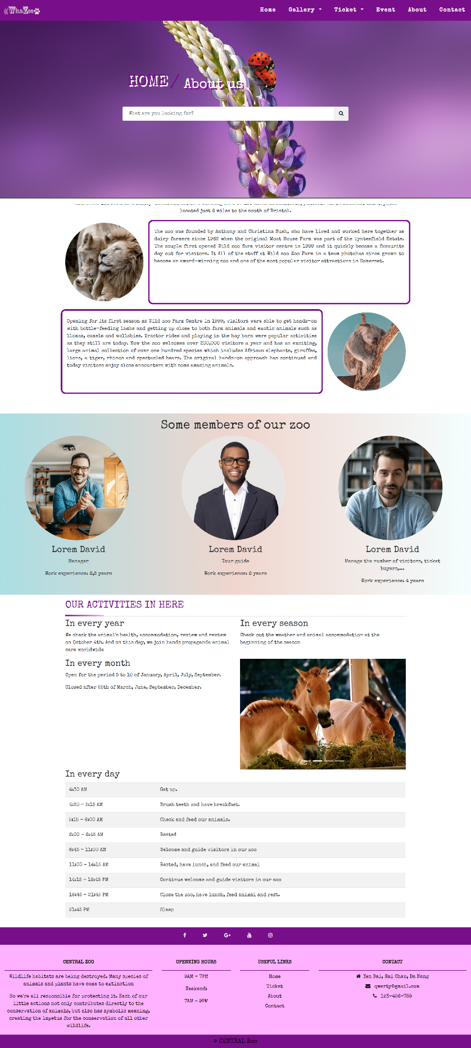
About

Slide 13
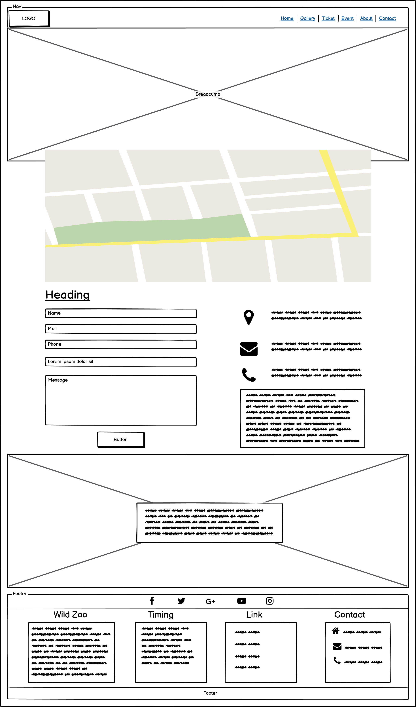
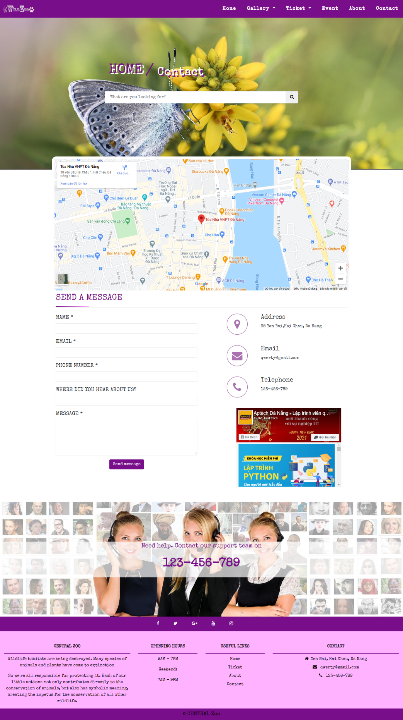
Contact

Slide 14
DEMO

Slide 15
CONCLUSION
Home
Librart Photo
Gallery
Comemorative Photo
Zoo Timing
Animal Detail
Ticket
Ticket
Event
About
Contact

Slide 16
CONCLUSION
However
this website also needs to be developed and upgraded.
Upgrade static web to dynamic web using Java, C #, PHP, Ruby ...
Build Back-end for the website
Create profiles to store user data
Build chat box for customer support
Mobile App Development
Complete the missing parts of the website

Slide 17
THANKS!
Any questions?

